Slide 1


Windows 10: Modern Device Management Workshop
Doug Wilson
@ManageDoug
dougw@nowmicro.com
Solutions and Product Manager, Now Micro
Brad Allgaier
BradA@nowmicro.com
Account Executive, Now Micro

Slide 2
Agenda
Community
About Now Micro
What is Modern Management?
Getting to a more Modern Management
Diving into Azure
  Azure AD + Hybrid Device
Microsoft Store for Education
Intune
Autopilot

Slide 3


Device Lifecycle Company
Hardware Reseller (Dell, HP, Lenovo, and more)
OEM (Digital Signage, Kiosks, Appliances)
Professional Services (Systems Management,
Cloud Solutions, Automation)

Slide 4


Get Invovled
Join or Start your local user group
Participate in forums
  Technet
  MyItForum
  Microsoft Tech Community
  Etc…
Get on Twitter
  Not just for celebrities and presidents
Keep a Blog

Slide 5
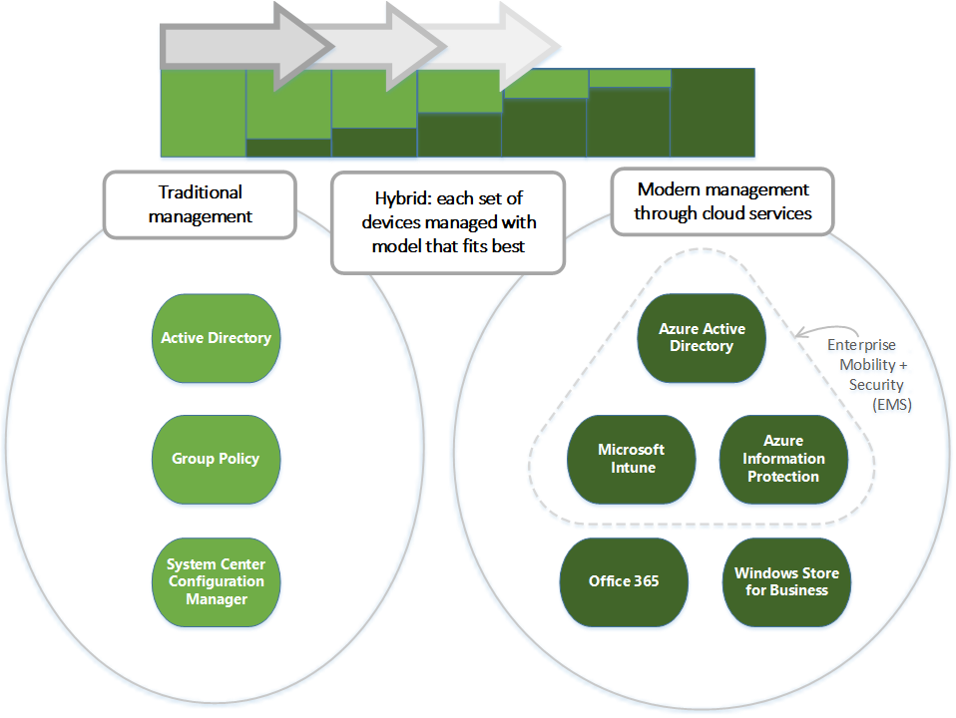

Slide 6
Why Modern Management?
Windows 10 is in a state of constant updates and upgrades
Wider variety of devices means a larger attack vector
We care about identity protection
We can empower users no matter what device they have to create a more rounded experience
Log Analytics

Slide 7
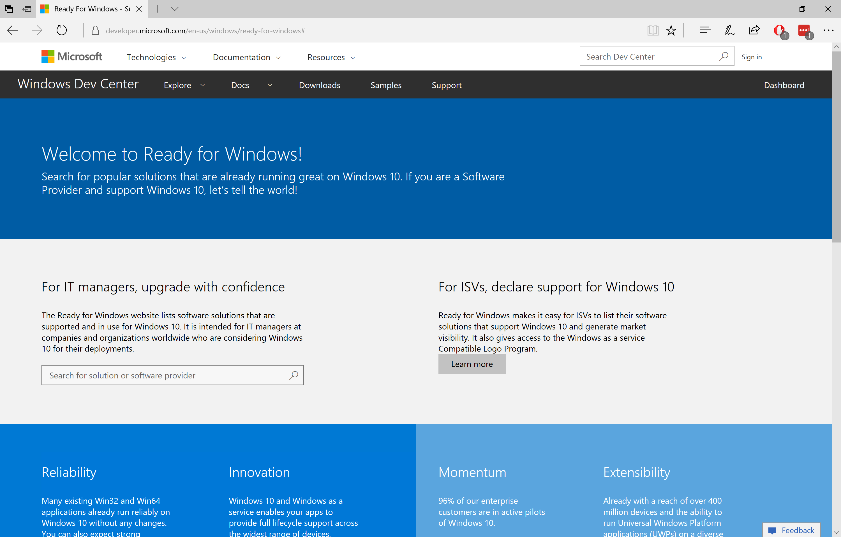
Ready for Windows
Get links to Windows 10 ISV support statements
Get usage information for every app version, and use that to target testing
http://www.readyforwindows.com
We are actively engaged with ISVs, to ensure full support for Windows as a service

Slide 8
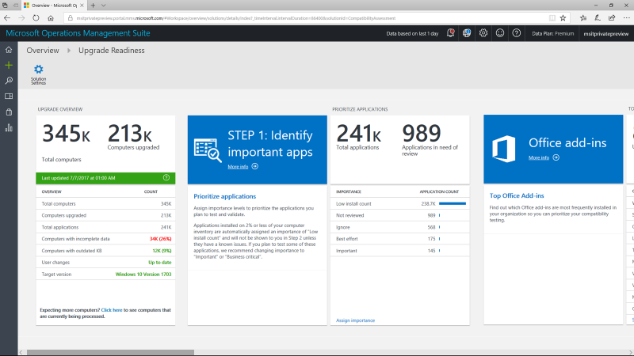
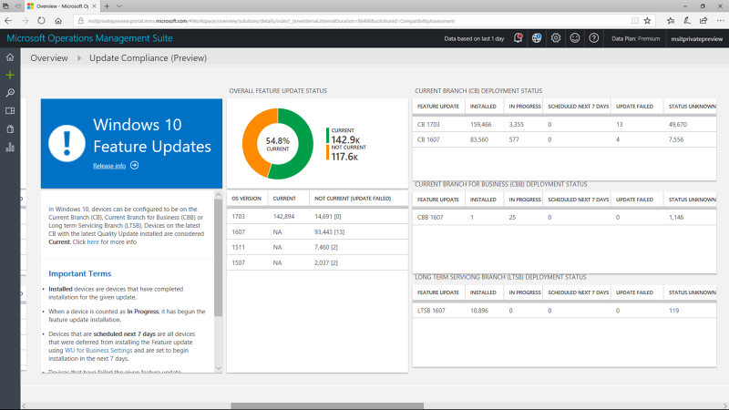
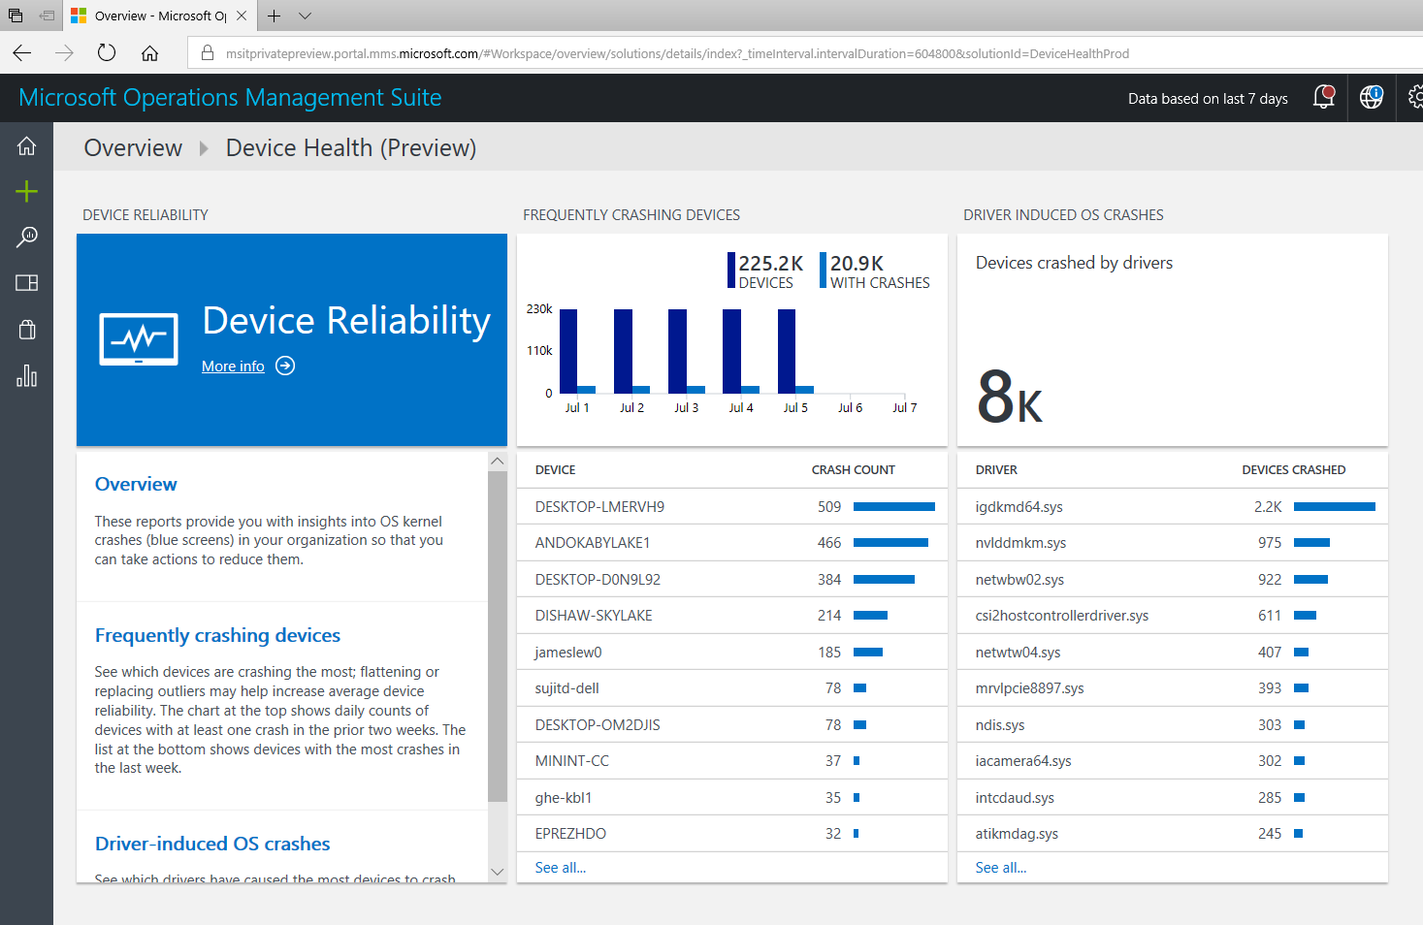
Windows Analytics
A suite of tools reduce deployment and support costs
Upgrade Readiness
Update Compliance
Device Health
Plan upgrades by identifying devices that are ready and identify and resolve top app/driver compat blockers.
Ensure update and antimalware compliance with timely reports for all your devices (even those on the road).
Reduce support costs by proactively identifying and remediating top end-user impacting issues.

Slide 9


Dive into Modern Management

Slide 10
Helpful Links
https://docs.microsoft.com/en-us/intune/custom-settings-windows-10
https://docs.microsoft.com/en-us/intune/
https://docs.microsoft.com/en-us/windows/deployment/update/waas-manage-updates-wufb

Slide 11
Windows 10: Modern Device Management Workshop
Doug Wilson
@ManageDoug
Solutions and Product Manager, Now Micro
Brad Allgaier
BradA@nowmicro.com
Account Executive, Now Micro

